Slide 1
Using Freestanding C++ to add C++17 to your Shellcode, UEFI, Embedded Systems and Unikernels.
Rian Quinn, Ph.D.
Chief Technology Officer

Slide 2



What is the goal of this presentation?
To learn how to run C++ from anywhere
IoT, Automotive, Embedded
Operating systems that do not support C++
Systems with no operating system at all
Kernels, Unikernels, Hypervisors
UEFI, BIOS
Shellcode, Flat binaries

Slide 3
What does “Freestanding” mean?
Any C or C++ compiled with the “-ffreestanding” compiler flag:
No access to standard headers
No access to standard libraries
No C runtime support
Usually requires support for “flat binaries”
(sometimes requires “-nostdlib” as well)

Slide 4

We will need to compile our own C++!
Since freestanding environments do not include any library support, including the C++ Standard Library, we will have to add an existing C++ library to our environment (our implement our own from scratch)
To do this, we will leverage Libc++ from the LLVM project:
https://github.com/llvm-mirror/libcxx
https://github.com/llvm-mirror/libcxxabi
https://github.com/llvm-mirror/llvm
We will also need a Libc:
https://github.com/bminor/newlib

Slide 5
Let’s start with the compiler flags
To compile these libraries in our freestanding environment, we will need the following flags:
--sysroot=<PATH>
Quirks
-D__ELF__
-D_LDBL_EQ_DBL
GNU/POSIX:
-D_GNU_SOURCE
-D_POSIX_TIMERS
-D_POSIX_THREADS
-D_UNIX98_THREAD_MUTEX_ATTRIBUTES
-DCLOCK_MONOTONIC
Intel Specific
--target=x86_64-elf
-fpic
You might also need
-mno-red-zone
-fdata-sections
-ffunction-sections
-std=gnu11/-std=gnu++17

Slide 6

We will need some linker flags too
To link these libraries in our freestanding environment, we will need the following flags:
--sysroot=<PATH>
Static Pie
-static
-pie
--no-dynamic-linker
You might also need:
-nostdlib
--gc-sections
--strip-all
-z max-page-size=0x1000
-z noexecstack

Slide 7
Don’t forget about your CMake flags
Libc++ need the following:
-DLLVM_PATH=<path>
-DLIBCXX_CXX_ABI=libcxxabi
-DLIBCXX_CXX_ABI_INCLUDE_PATHS=<path>
-DLIBCXX_SYSROOT=<path>
Static Only
-DLIBCXX_ENABLE_SHARED=OFF
-DLIBCXX_ENABLE_STATIC=ON
Controls
-DLIBCXX_HAS_PTHREAD_API=ON
-DLIBCXX_HAVE_CXX_ATOMICS_WITHOUT_LIB=ON
-DLIBCXX_ENABLE_FILESYSTEM=OFF
-DLIBCXX_ENABLE_EXPERIMENTAL_LIBRARY=OFF
Libc++abi need the following:
-DLLVM_PATH=<path>
-DLIBCXXABI_LIBCXX_PATH=<path>
-DLIBCXXABI_SYSROOT=<path>
Static Only
-DLIBCXX_ENABLE_SHARED=OFF
-DLIBCXX_ENABLE_STATIC=ON
Controls
-DLIBCXX_HAS_PTHREAD_API=ON
-DLIBCXXABI_INCLUDE_TESTS=OFF

Slide 8
What about Newlib?
Libc (i.e., Newlib) will need the following:
--target=x64_86-elf
--prefix=<path>
--disable-libgloss
--disable-multilib
CFLAGS_FOR_TARGET=<flags>
CC_FOR_TARGET=clang
Post-Compile Steps
Newlib will place everything in prefix/target/*, and we want everything in prefix/* to match CMake’s environment, so we will need some post-compile file copy magic after Newlib compiles

Slide 9

Some Notes!!!
Headers:
Both libc++ and libc++abi will need access to the includes that Newlib spits out: -isystem prefix/include
Your C++ application will need access to the includes provided by newlib, libc++ and libc++abi. Your C++ application will also need all of the flags (both compiler and linker) previously defined. DO NOT make the mistake of including the libc++ and libc++abi headers in your flags when compiling libc++ and libc++abi. Doing this will result in really strange compiler errors
-mno-red-zone
If you are working in ring 0 on Intel/AMD, make sure you include –mno-red-zone. This flag turns off an optimization in the SysV ABI that is not compatible with interrupts.

Slide 10
What’s missing? 🤯
Unwinder
Provides support for C++ exceptions. Most of the existing Unwinders are all OS specific which will not work with freestanding environments
C Runtime
Provides _start()
Runs functions defined in .init, .fini, .init_array, .fini_array, .ctors, .dtors,
Registers unwinder with .eh_frame (and friends) sections
Executes main() with argc, argv and envp
POSIX threads
Provides support for threads, mutexes and conditional variables.
System Calls
Implements the system level functions that Newlib doesn’t have support for since we didn’t include Libgloss including simple things like outputting to a console

Slide 11

Unlike C, C++ requires additional “sections” to execute properly

Slide 12
Do we need an ELF Loader?
Short answer is no:
You could implement everything with a custom linker script. This however is not a simple task, and will likely result in unexpected, hard to debug issues unless you really know what you are doing.
Once you are done with your custom linker script, you will likely realize you have simply re-implemented the ELF spec anyways.
The ELF Spec
Defines a file format with each section that is needed to properly execute your C++ application
Defines how to load this C++ application in memory, including locations, sizes and permissions.
Provides your C runtime with everything needed to execute, link and register
Wait!!! We are talking about a freestanding environment… Can we assume ELF is supported!!!

Slide 13
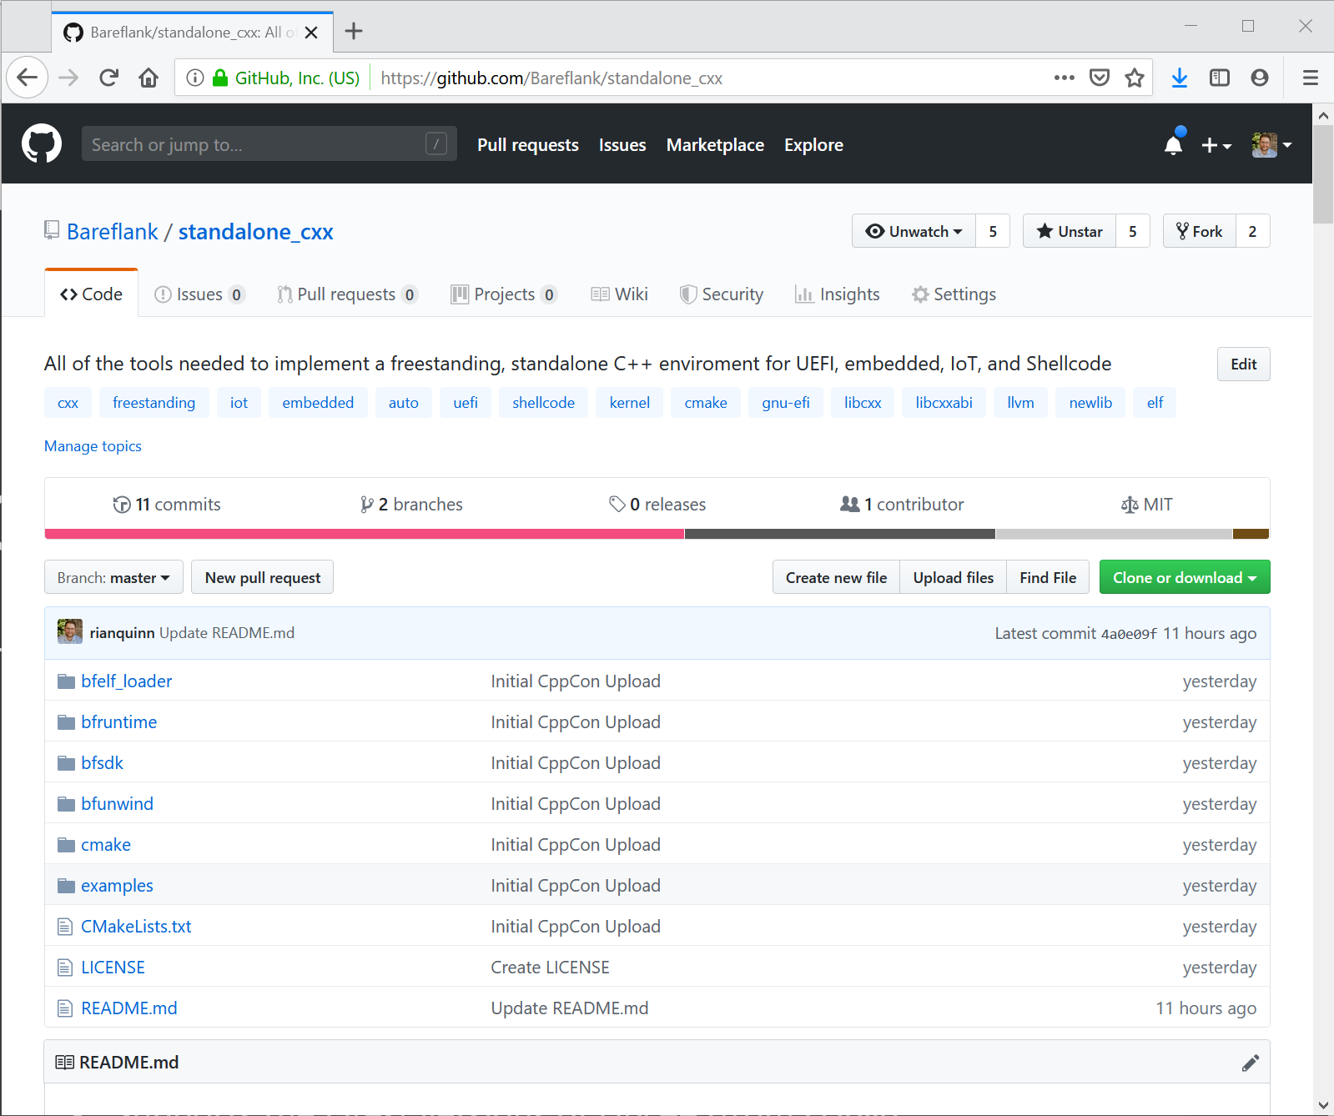
Our approach
The Bareflank Hypervisor has been using C++ in a freestanding environment for several years.
We moved this implementation of C++ into its own project, so that others can easily include C++ in their own projects.
Like Bareflank, the Standalone C++ Project is:
Completely open source (MIT)
Supports the latest versions of Libc++ (from LLVM)
Includes support for C++ 17
Includes support for C++ exceptions
Includes its own, header-only ELF loader (that only depends on “stdint.h”)

Slide 14
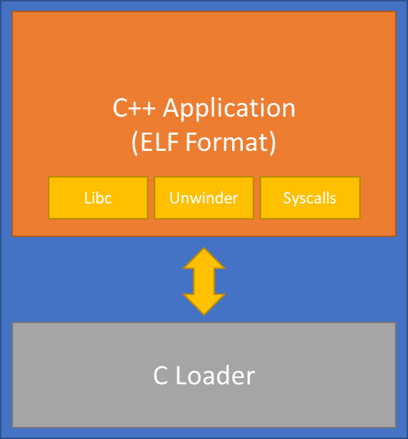
How does it work?
C++ Application (ELF Format)
The C++ application contains two components: A C++ Application and a Loader
The C++ application is stored in the ELF file format, and contains its own Libc with runtime support, an Unwinder for exception support, and a system call interface for device/kernel support.
The loader contains an ELF loader that loads/relocates the C++ application and then executes it.
Both can be compiled with “-ffreestanding”.
C runtime
Unwinder
Syscalls
C Loader
bfexec
Alloc/Free
Syscalls

Slide 15
The C++ Application

Slide 16
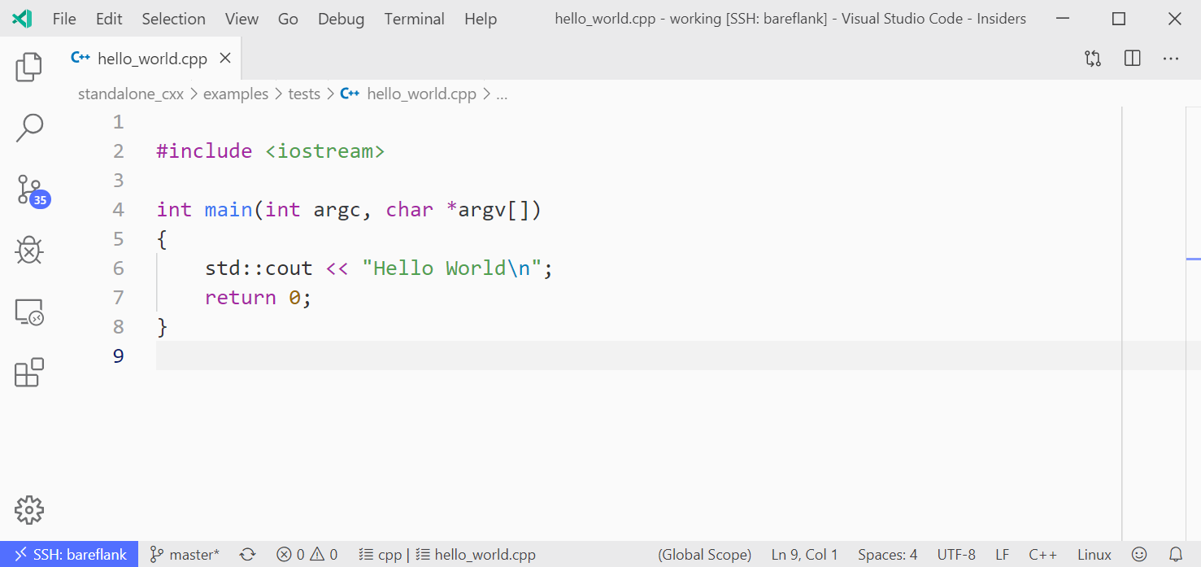
Step 1: You need a C++ application

Slide 17
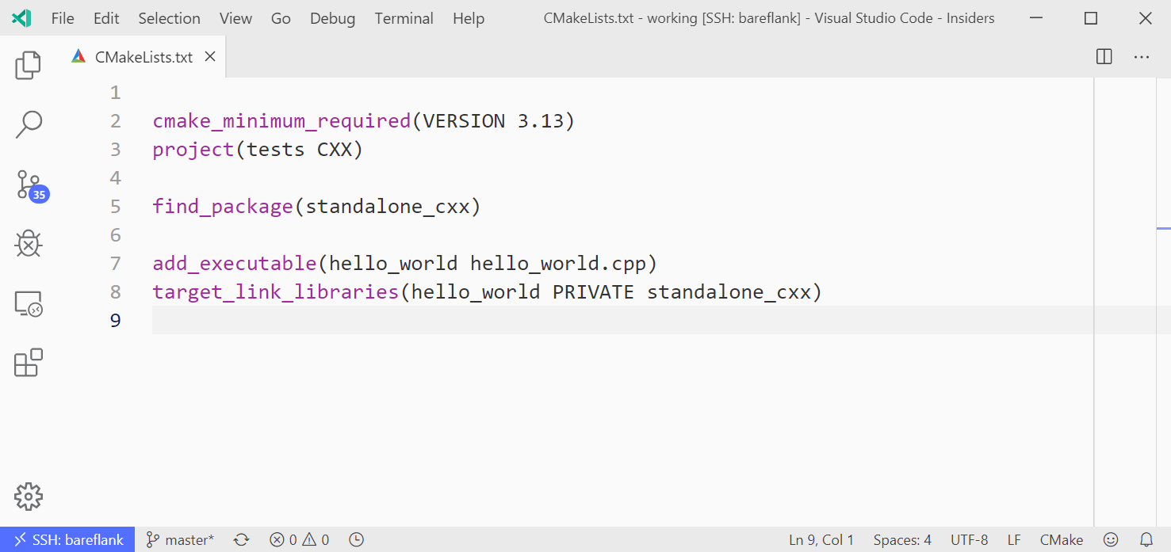
Step 2: You need a way to compile your app

Slide 18
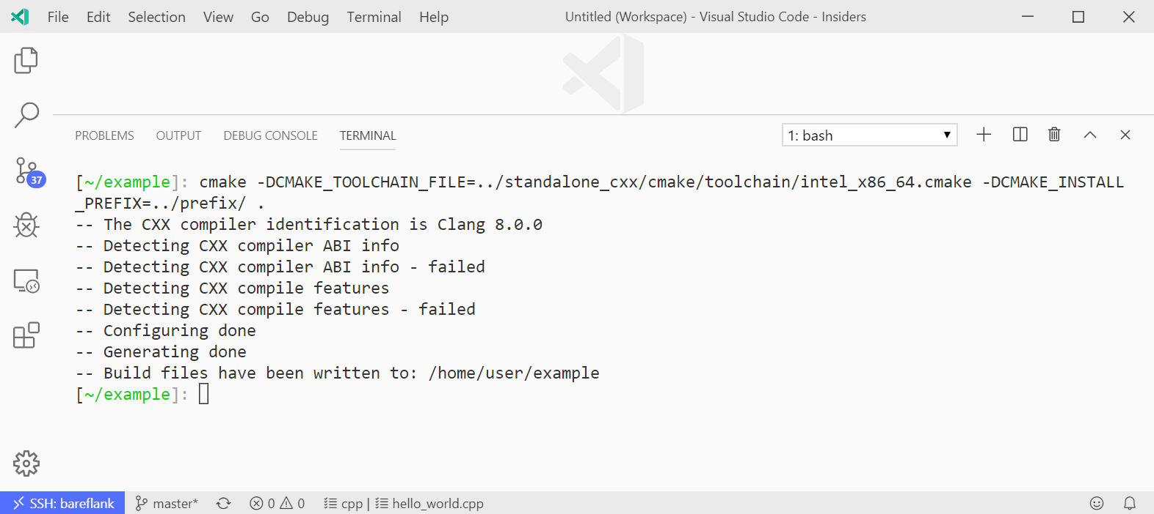
Step 3: Configure
Don’t forget your toolchain and prefix

Slide 19
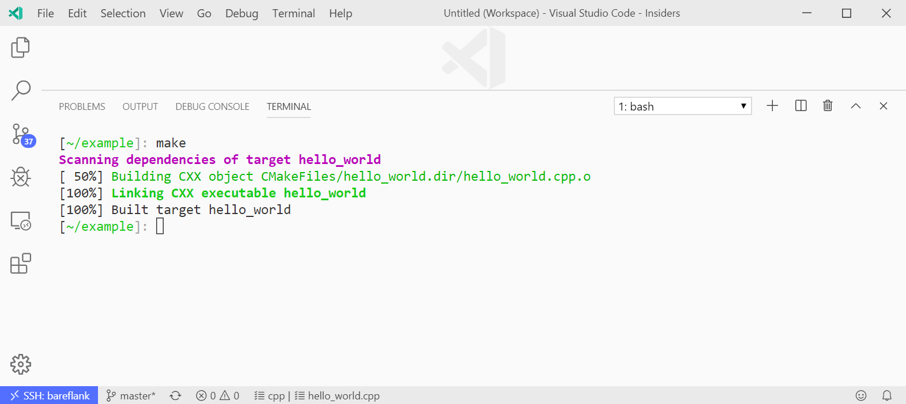
Step 4: Build

Slide 20
The Loader

Slide 21
What is the loader?
The loader is your freestanding application
For example, it could be:
A kernel module
A thread-x applications
A UEFI application/driver
A legacy BIOS boot loader
Shellcode
The loader is whatever your “entry point” is, likely written in C, and likely contains its own build environment, or is a flat binary.
The loader runs “bfexec” which is a header-only, ELF loader API, similar to “execv”, that only depends on stdint.h (and friends like stddefs.h)

Slide 22
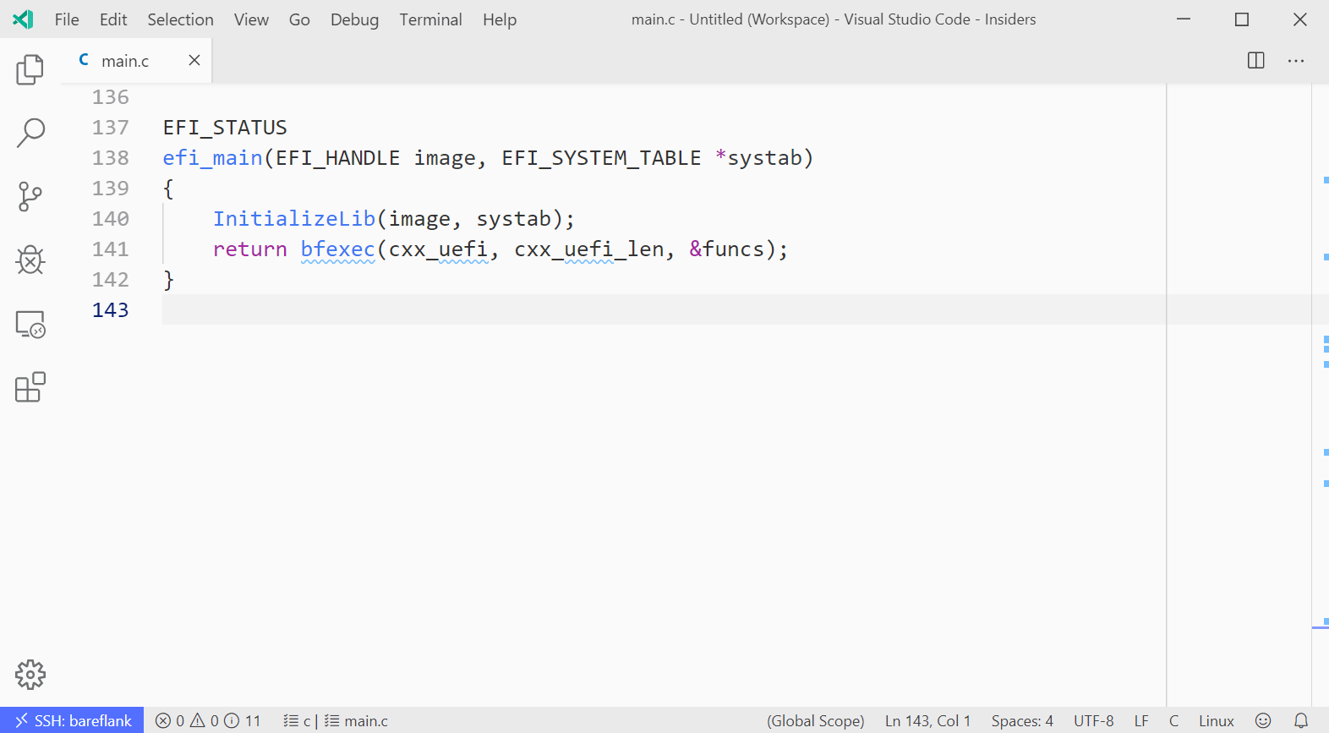
UEFI: The Entry Point

Slide 23
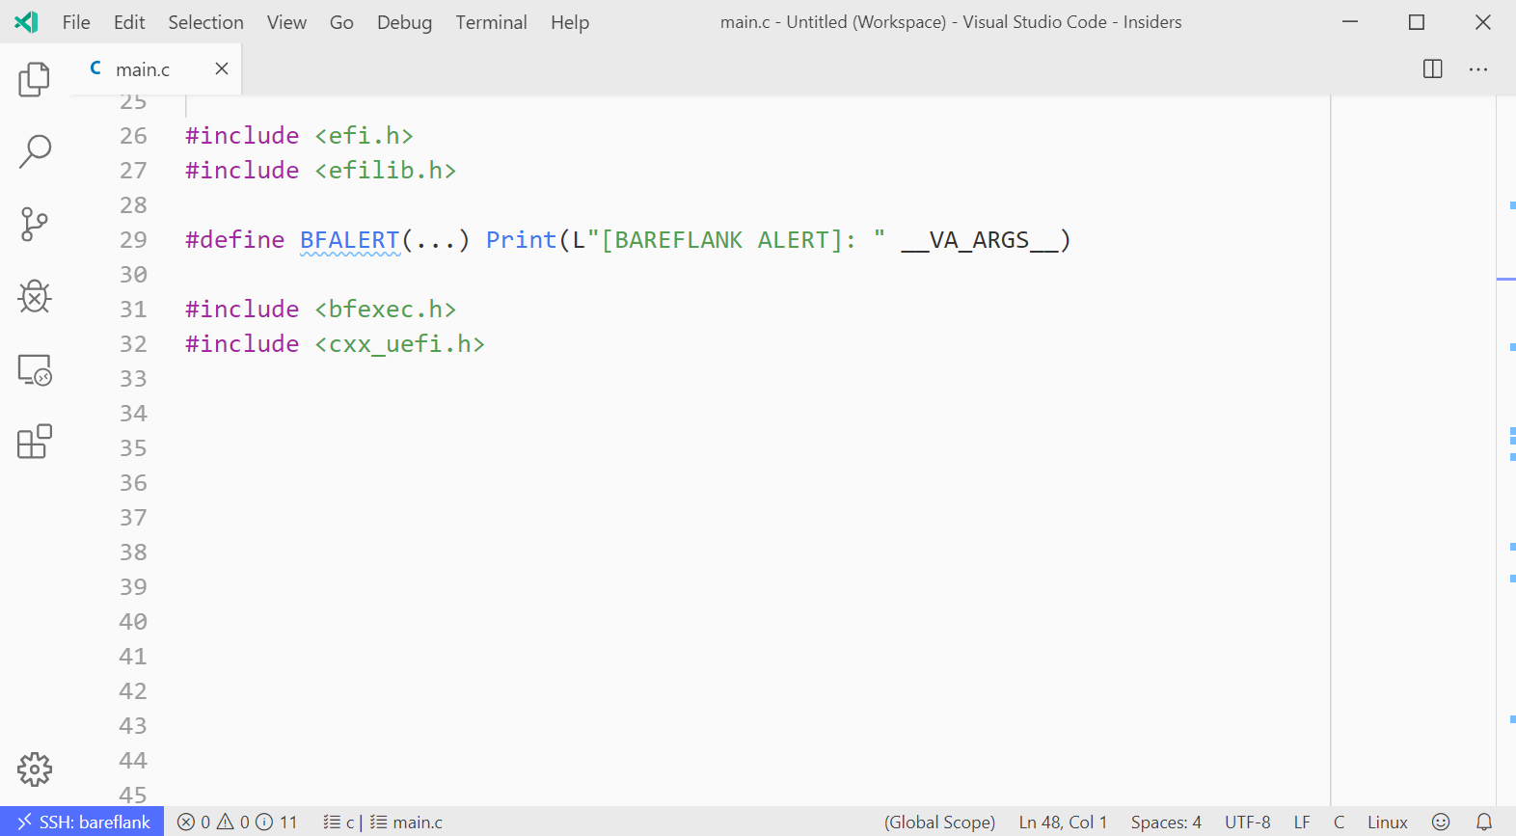
UEFI: The Headers

Slide 24
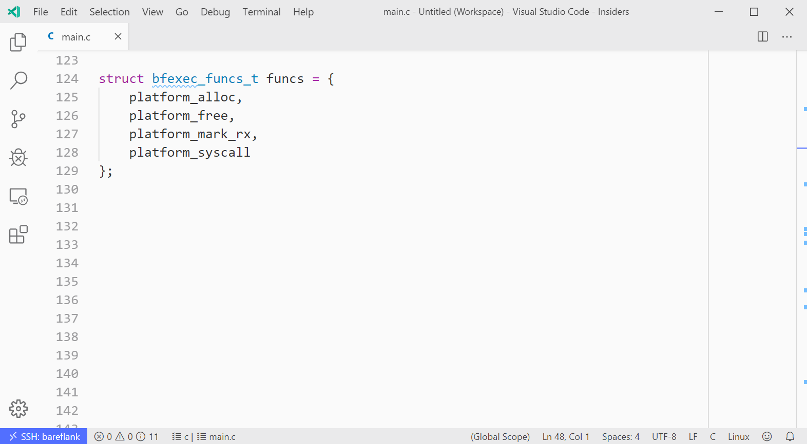
UEFI: The Helper Functions

Slide 25
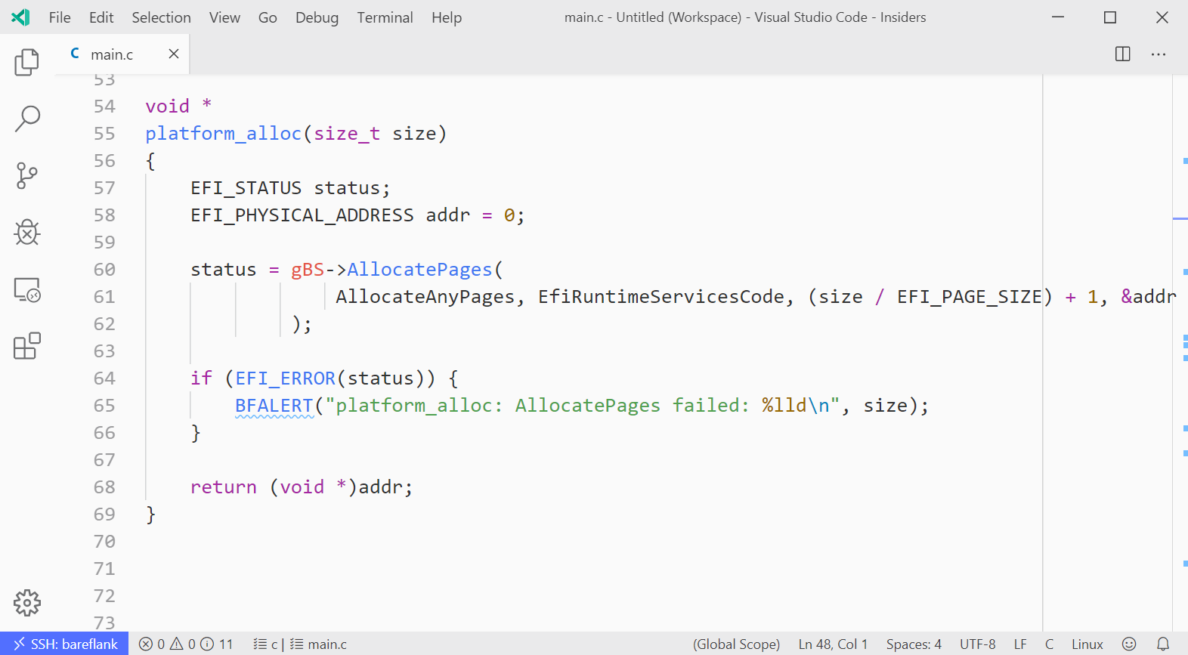
UEFI: The “Alloc” Function

Slide 26
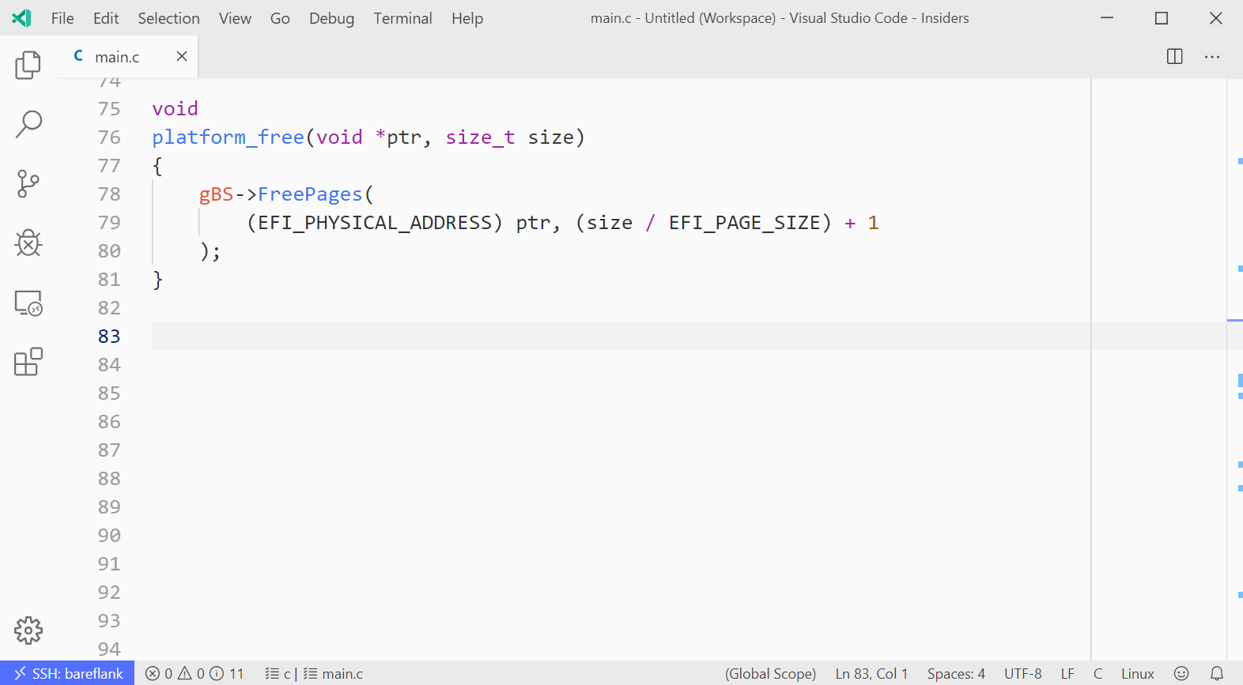
UEFI: The “Free” Function

Slide 27
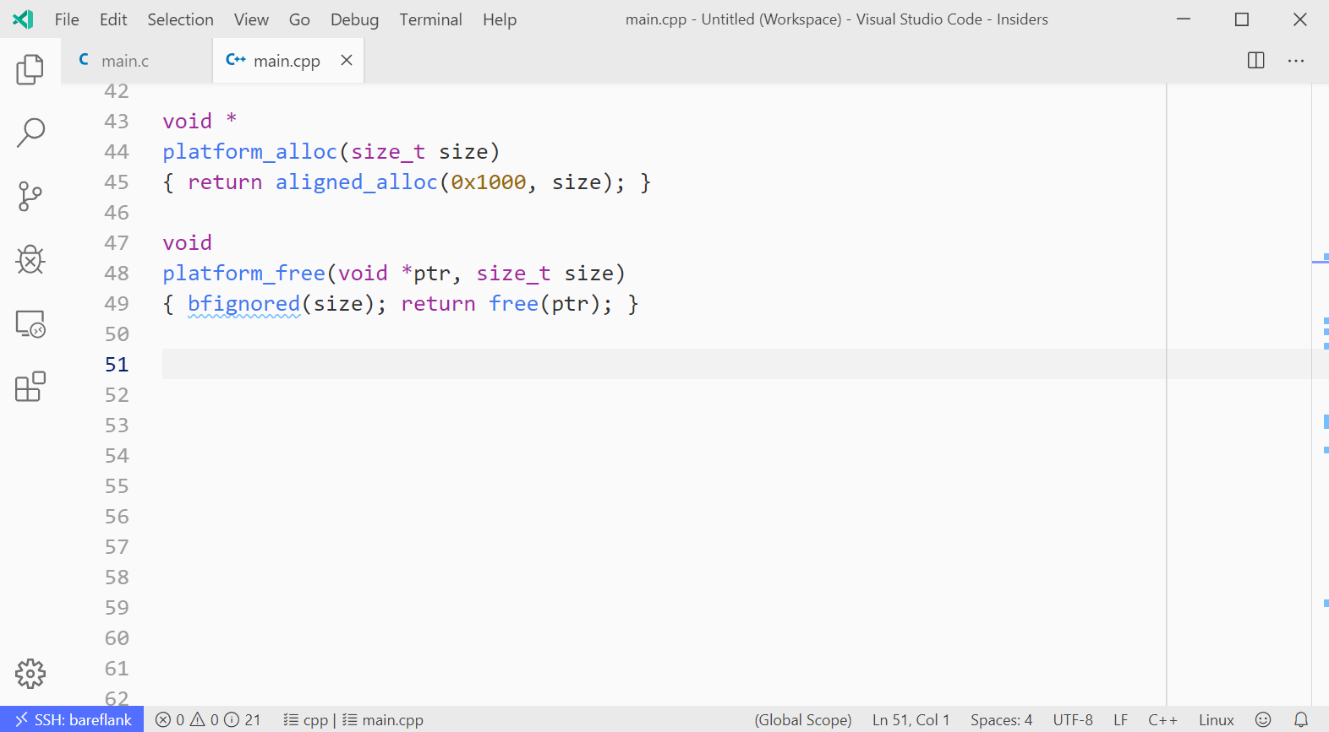
UEFI: Many ways to implement these

Slide 28
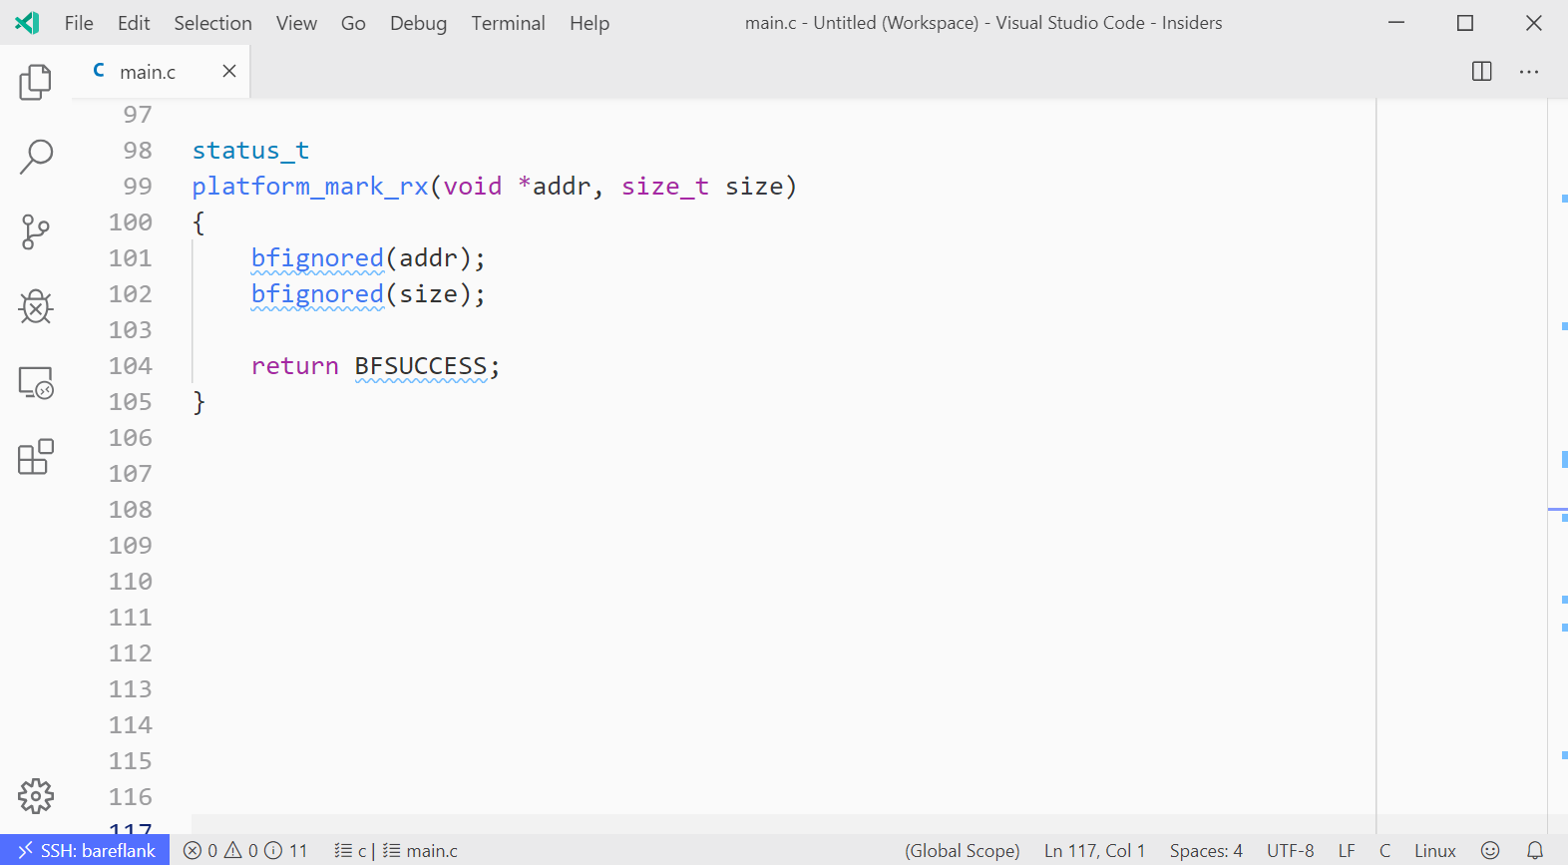
UEFI: The “Mark RX” Function

Slide 29
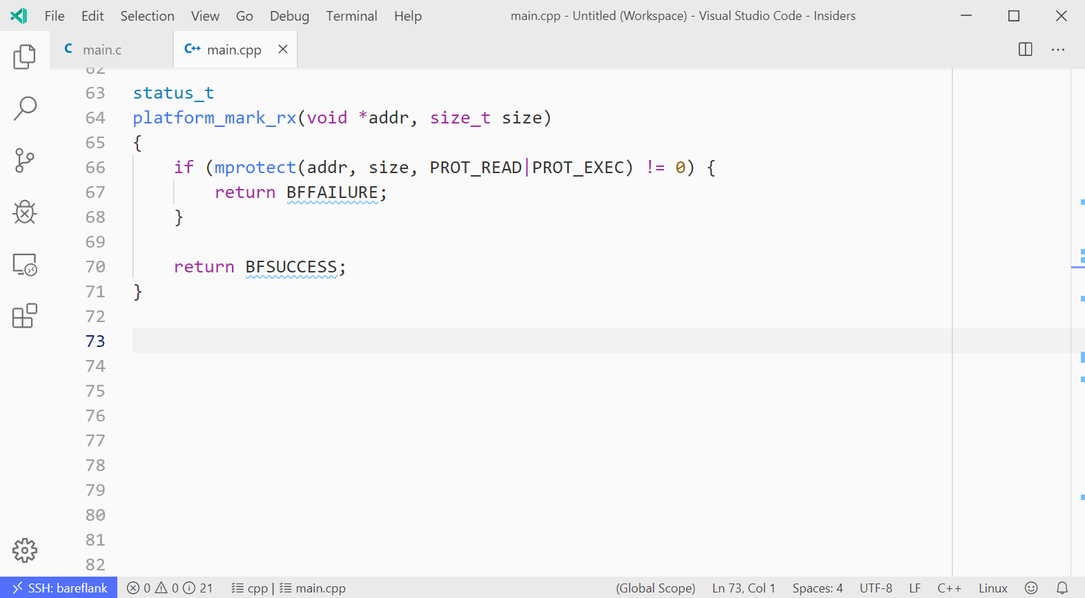
UEFI: The “Mark RX” Function

Slide 30
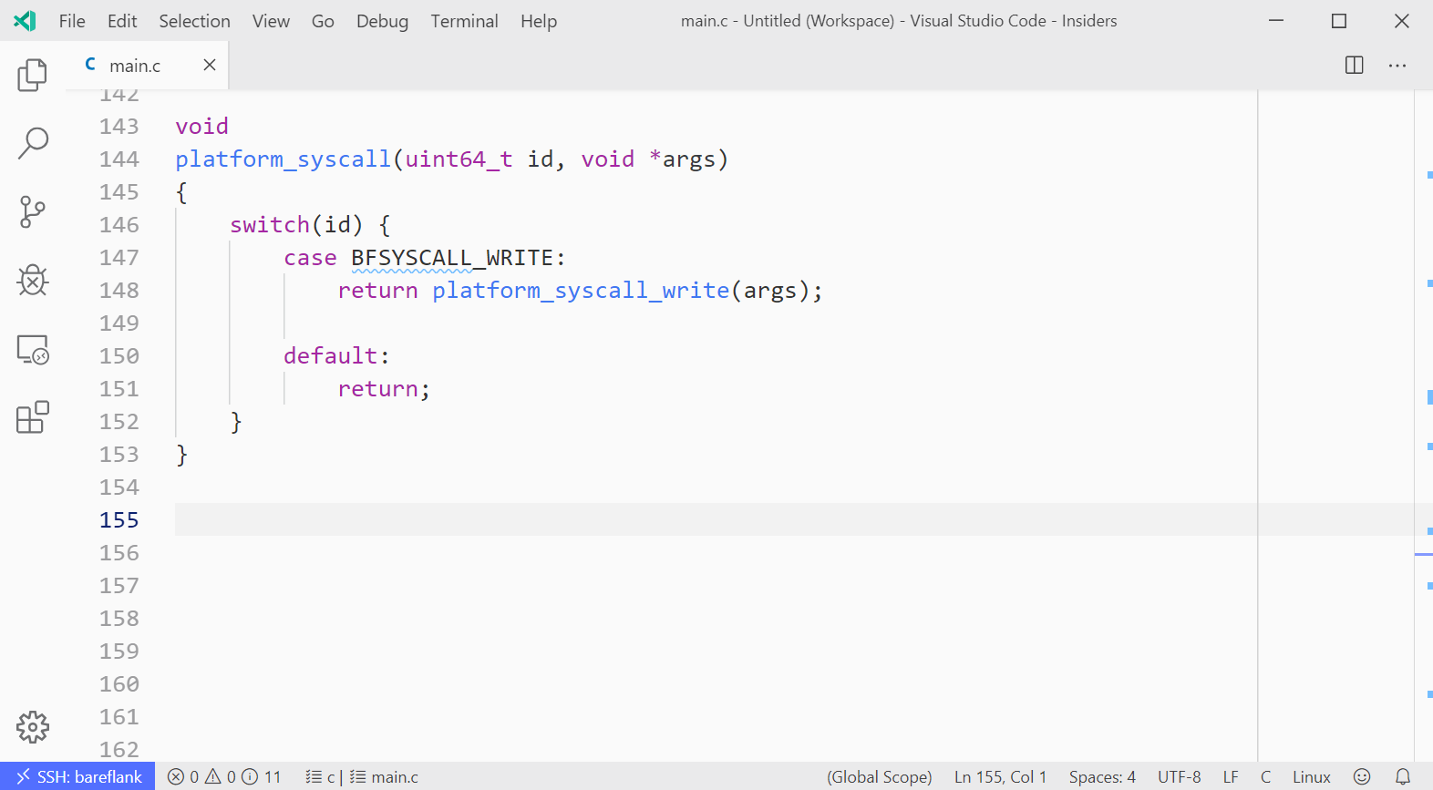
UEFI: The “Syscall” Function

Slide 31
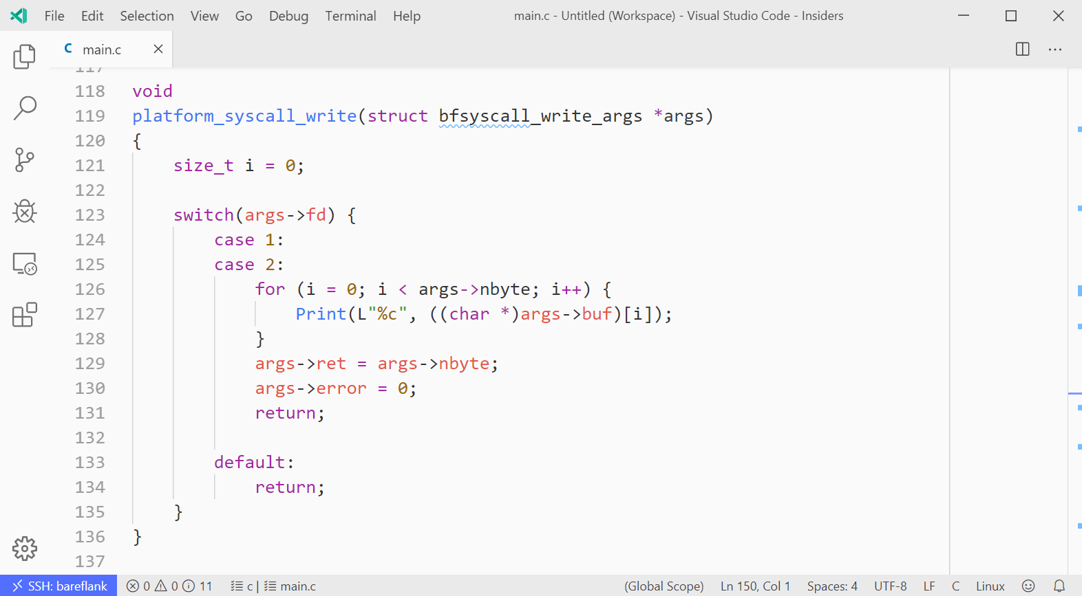
UEFI: The “Syscall” Function

Slide 32
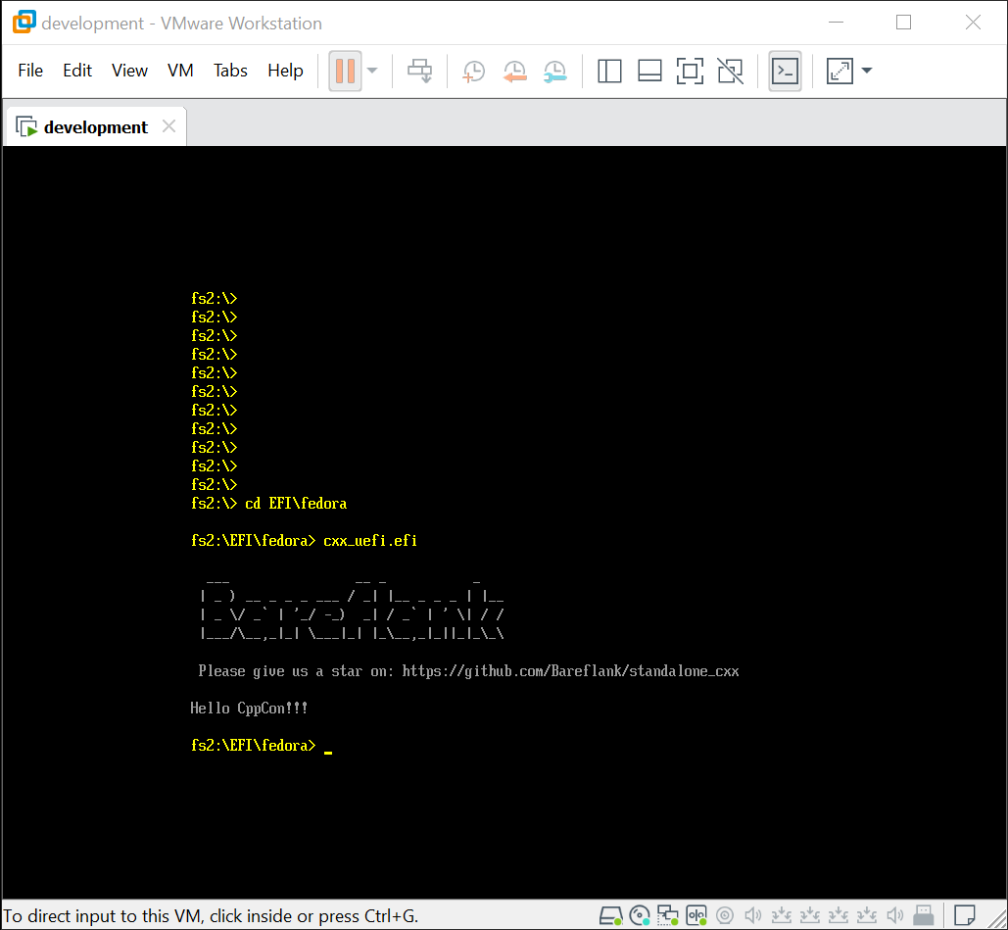
UEFI: Demo

Slide 33
Demo: Shellcode
Buffer
Stack Direction
Fill Buffer Direction
Other Variables
Return Address

Slide 34
Limitations?
Architecture Support:
Only supports Intel/AMD 64bit. We plan to add support for ARM 64bit and MIPS 64bit
No plans for 32bit (although 32bit loaders are supported)
Position Independence
Only supports “static pie”. We plan to add support for static no-pie
No plans for shared library support
Windows Support
Only compiles on Linux. We plan to add support for Windows (via Cygwin)
Cross-compiling is currently supported as well
POSIX Threads Support
Only supports mutexes and conditional variables.
We would like to add thread support with the ability to define your own scheduling.
Libc
Newlib is missing functionality, doesn’t compile on Windows natively, and doesn’t support other archiectures well. It is also a lot larger than needed.
We would like to implement our own Libc, specifically for Libc++

Slide 35
Questions?
Email: rianquinn@gmail.com
Standalone C++: https://github.com/Bareflank/standalone_cxx

